Slide 1

Customer Ratings Analysis

Slide 2
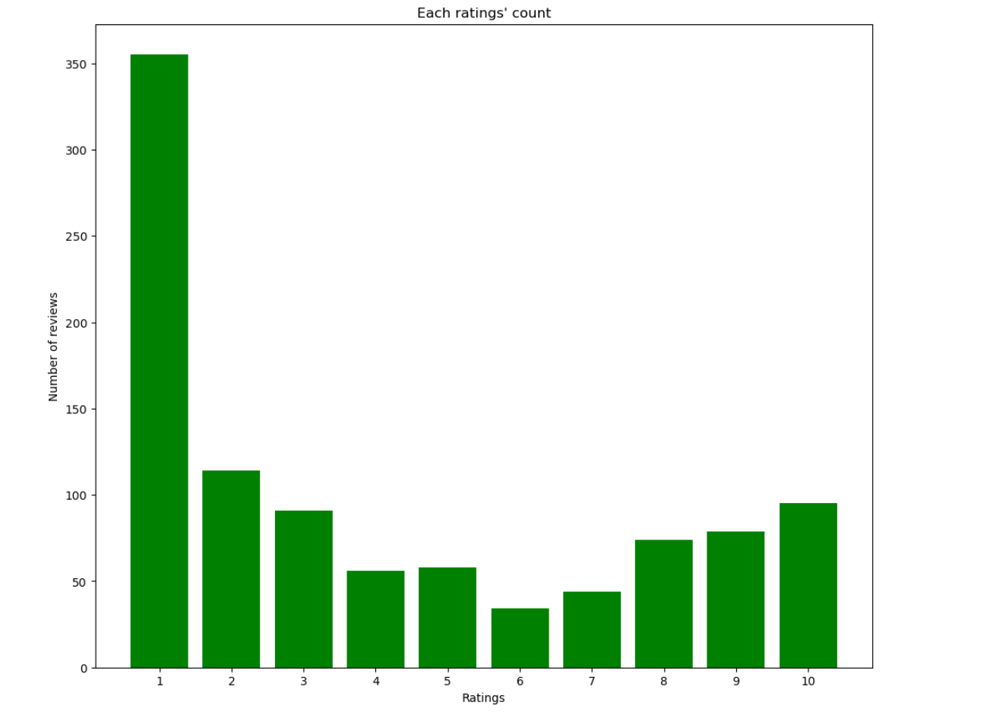
Analysis
Total 1000 reviews were collected and analyzed
Reviews are from 55 different countries
Reviews’ ratings ranges from 1 to 10
Average overall rating is 4.14
Most of the reviews are from United Kingdom

Slide 3
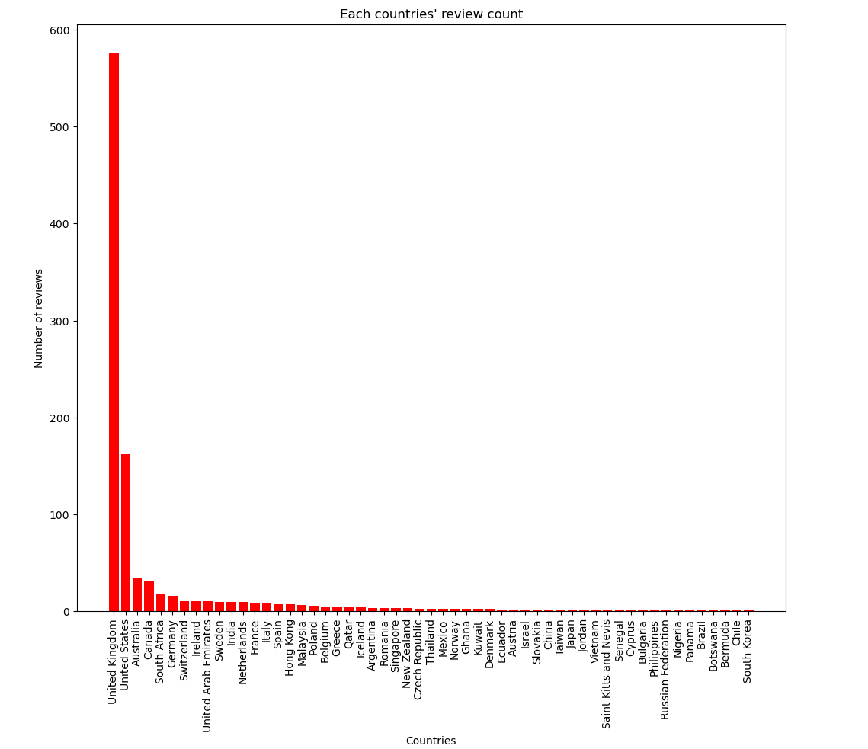
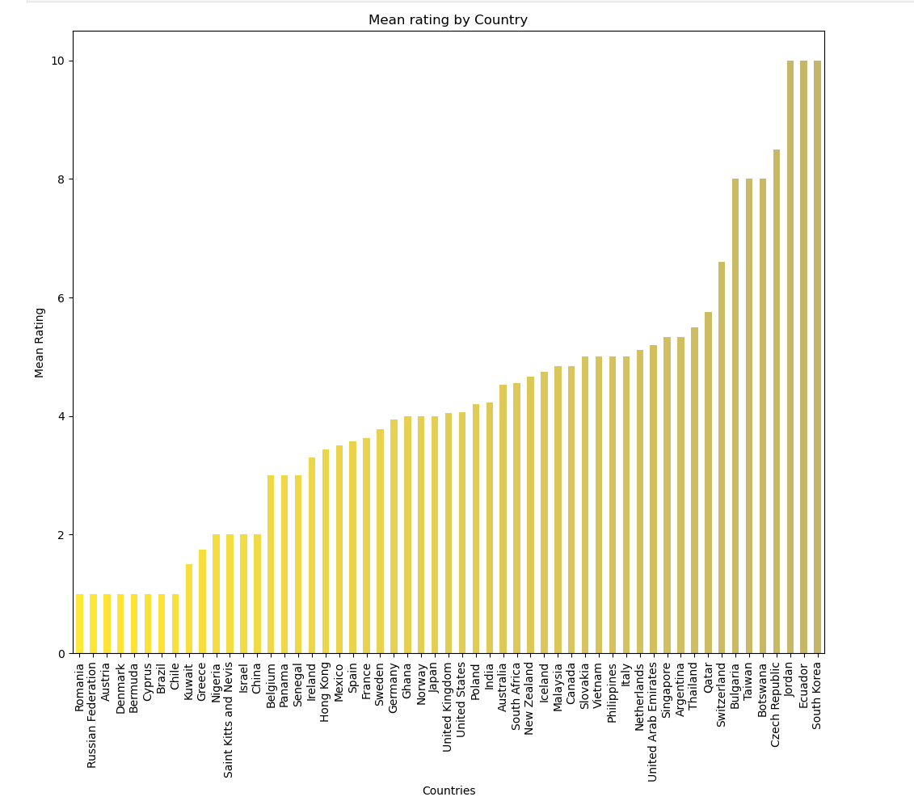
Analysis

